Slide 1
Recent Advances of LLM for Time Series
Yuyuan Feng (冯昱源)
Msc, School of Software
Xiamen University
Zhou et.al, One Fits All: Power General Time Series Analysis by Pretrained LM, NeurIPS 2023 spotlight
Jin et al, Time-LLM: Time Series Forecasting by Reprogramming Large Language Models, ICLR 2024

Slide 2
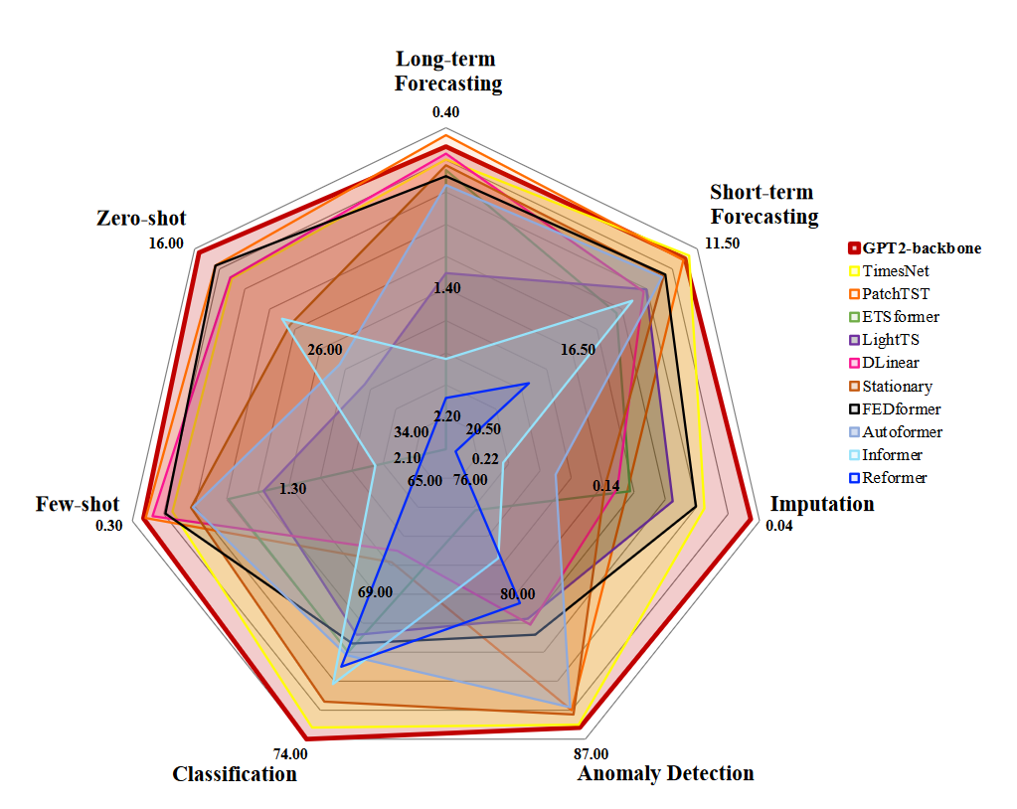
Motivation
预训练语言模型蓬勃发展，而时间序列上一个统一的、适用于多种下游任务的预训练基础模型尚未出现
时序领域中最大的数据集仍<10B, 不足以训练PLM级别的大模型
所有任务均表现好

Slide 3
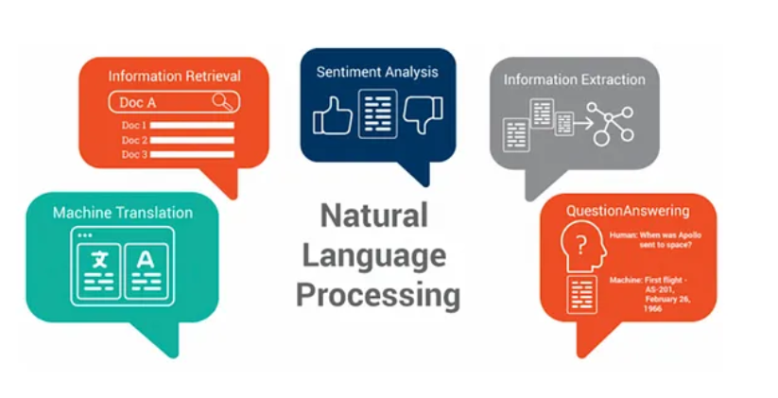
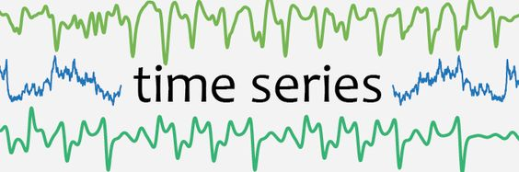
Outline
What are LLMs & Time series?
OFA
Code reading & Customize for your own dataset
Concurrent works & future directions

Slide 4
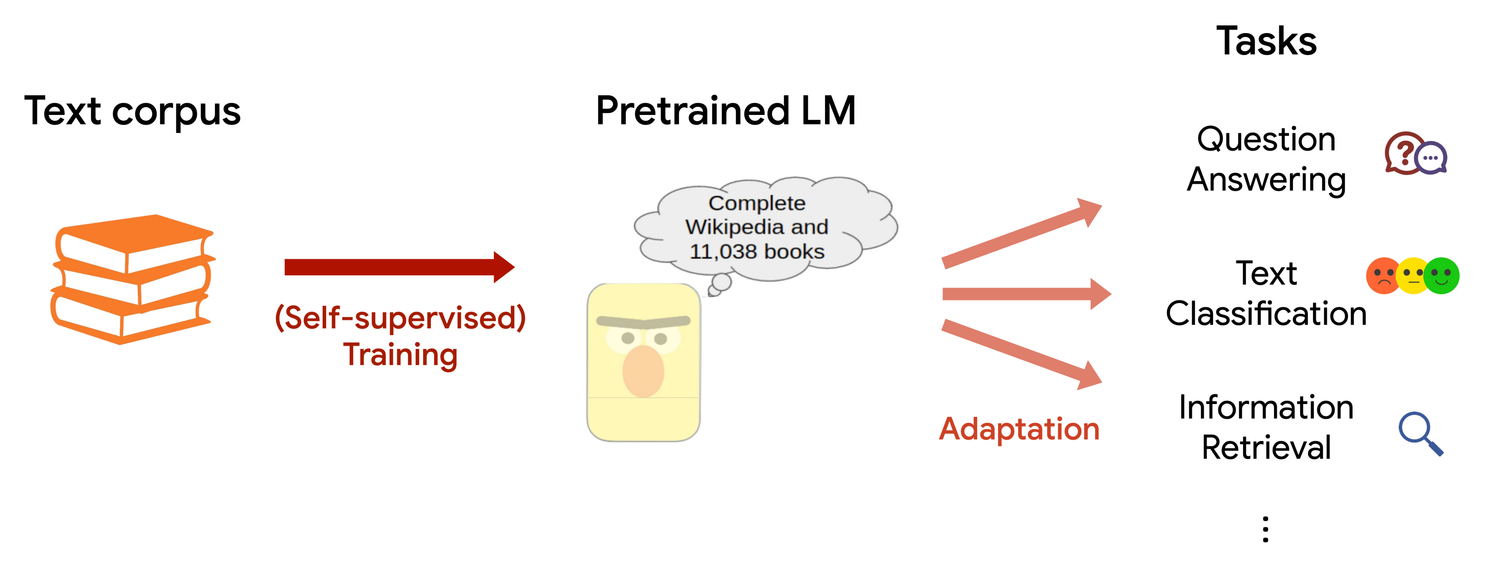
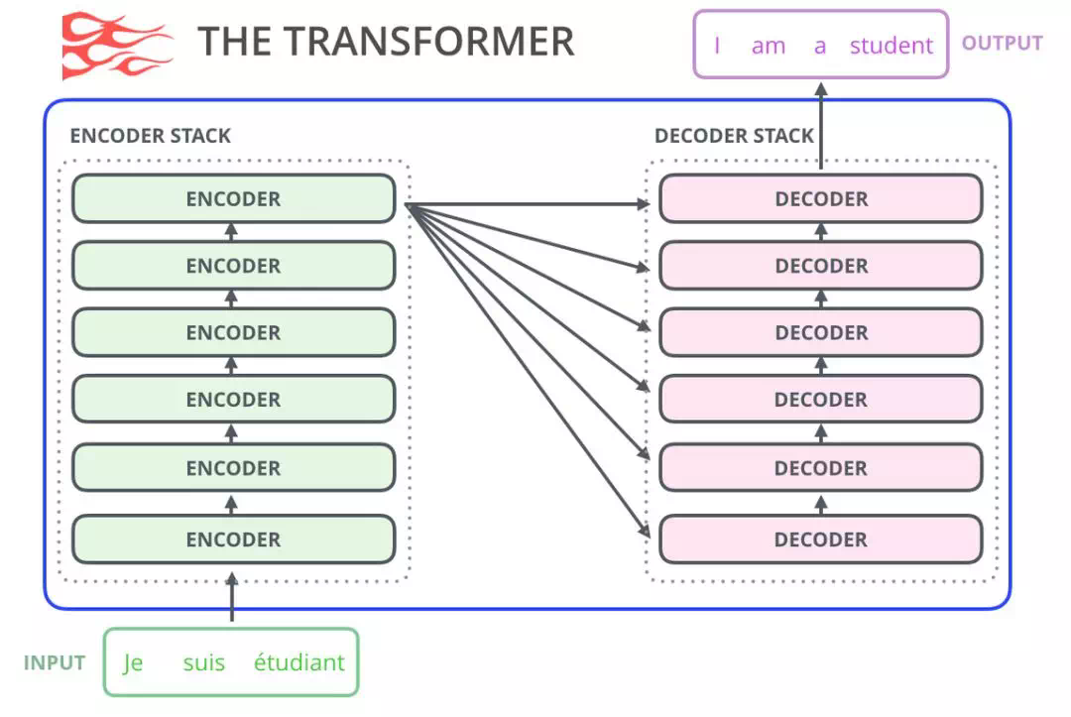
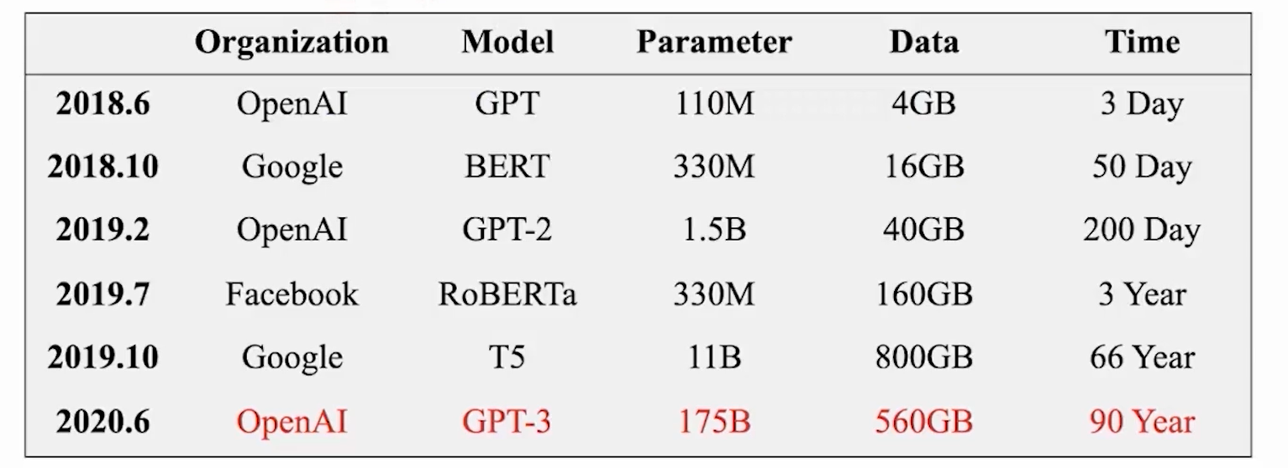
From LM to PLM (Pre-trained language model)
What is a PLM?
Use just one stack of transformer blocks
Unsupervised Pre-training on large text corpora
Adapt to various downstream tasks
基于Transformer的语言模型
多种多样的预训练语言模型

Slide 5
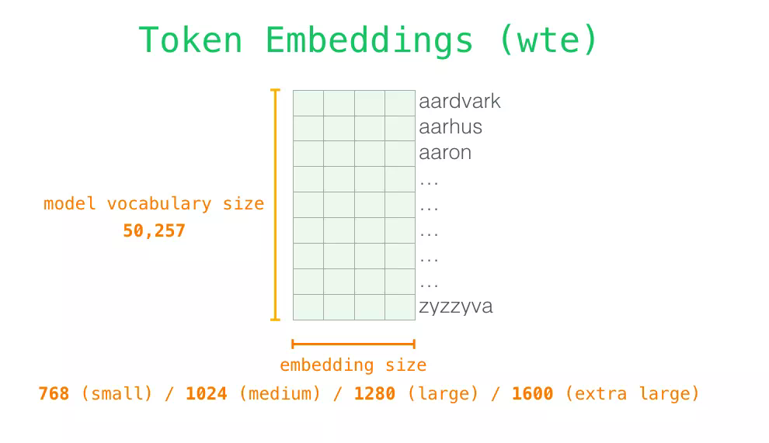
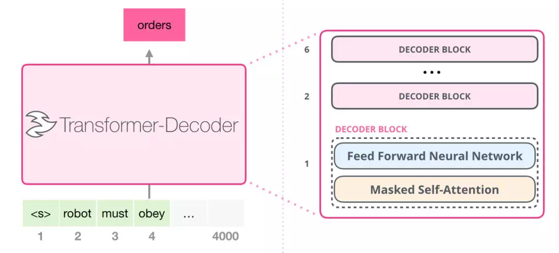
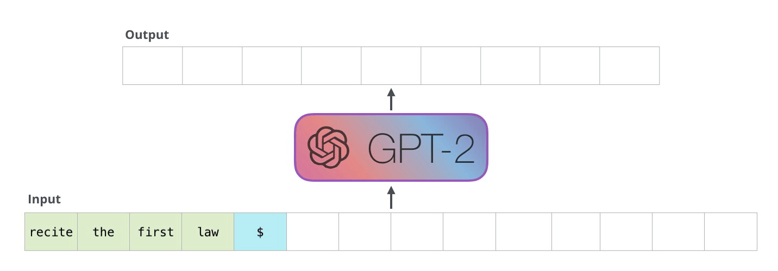
GPT2
Transformer Decoder
Auto-regressive (both training and interference)
Word Vocabulary (both input and output)
Notes:
这篇论文用的大模型是GPT2，我们先了解下gpt2~ 从PLM三个特征角度看

Slide 6


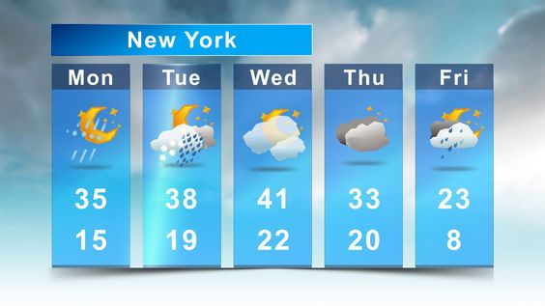
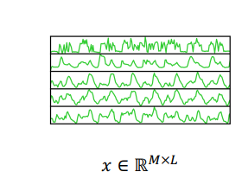
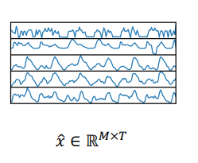
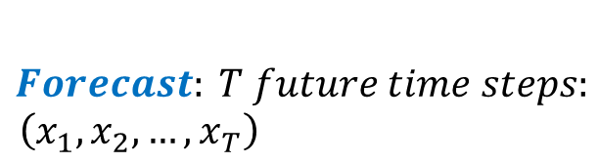
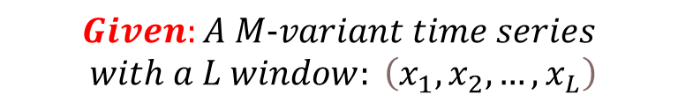
What is Time Series Forecast?
$$Forecast: T future time steps:$$
$$\left(x_{1}, x_{2},…, x_{T}\right)$$
$$Given:A M−variant time series$$
$$with a L window: \left(x_{1}, x_{2},…, x_{L}\right)$$

Slide 7
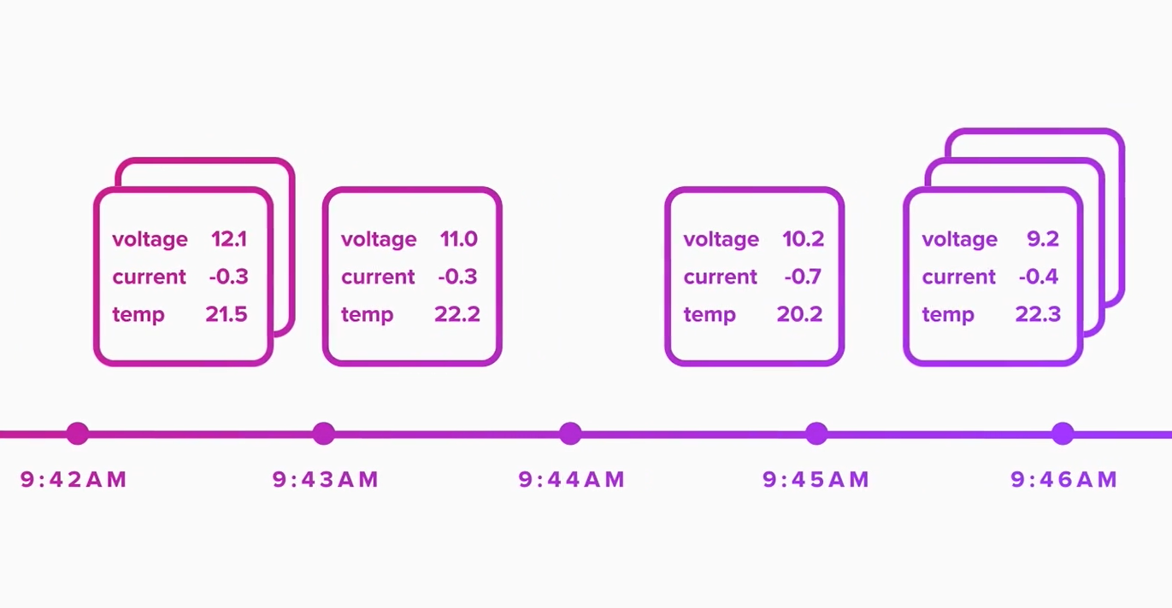
Representation Difference
Sequence representation:
[seq_len, feature_len]
For example, a battery discharging process below creates a [seq_len, 3] time series.
Word representation:
[words, word_vec]
For example, the word vocab of GPT2 has 50257 words with a 768 vector dim.

Slide 8
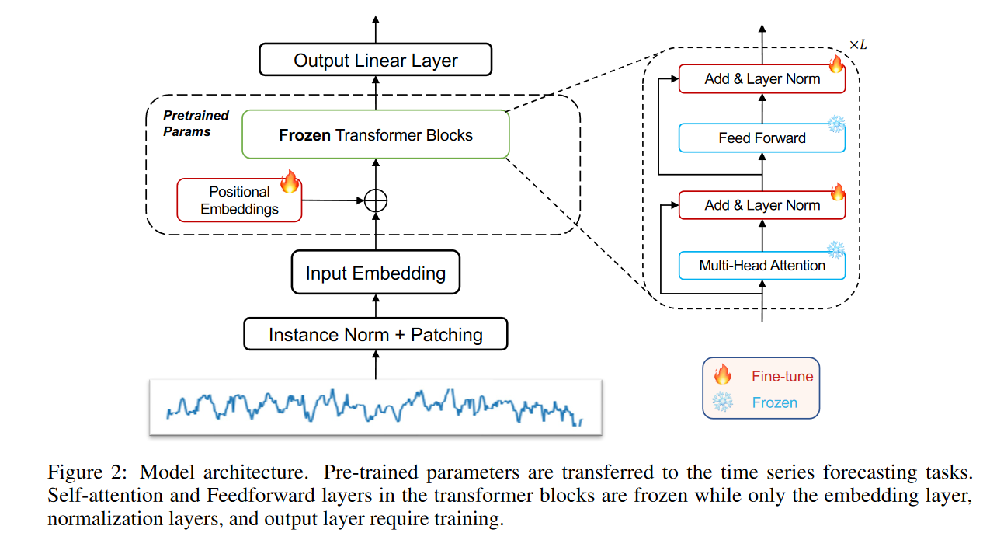
Model
Nie, et.al, A Time Series is Worth 64 Words: Long-term Forecasting with Transformers, ICLR 2023
输入：Patching + Embedding (Linear)
模型：微调Pos embed + Layernorm
输出：Linear layers
Zhou et.al, One Fits All: Power General Time Series Analysis by Pretrained LM, NeurIPS 2023 spotlight

Slide 9
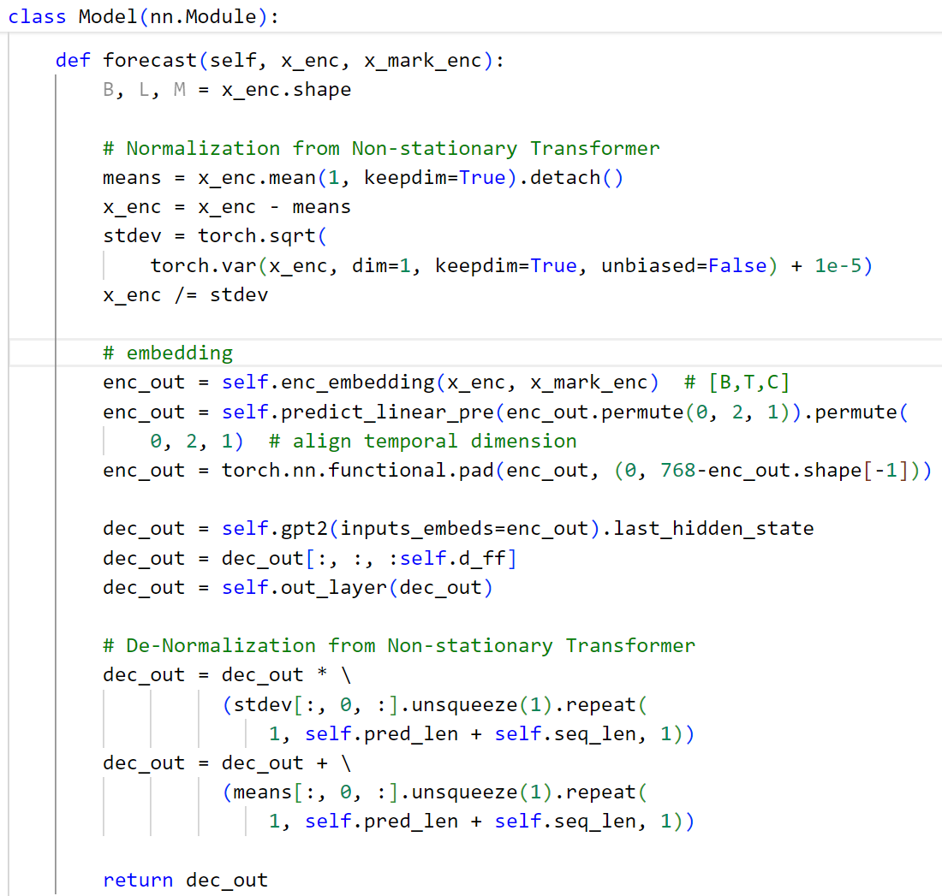

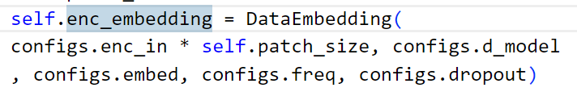
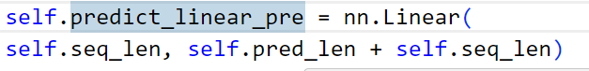
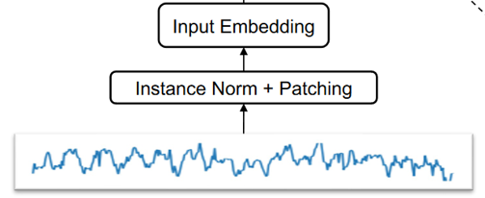
Code_Input
输入：Patching + Embedding(Linear)
task/models/GPT4TS.py

Slide 10


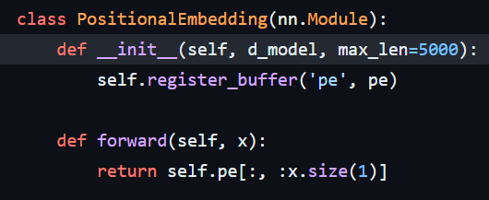
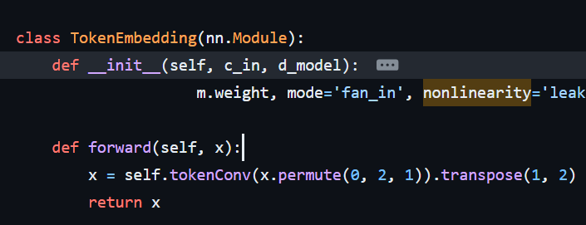
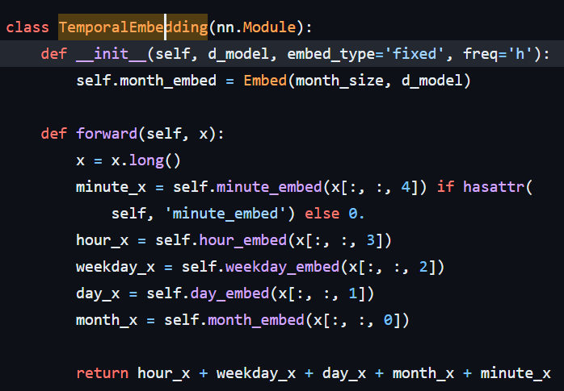
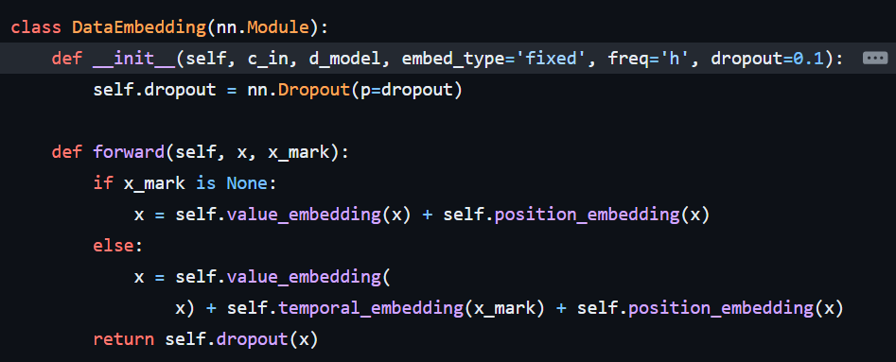
Code_Input
Zhou et.al, FEDformer: Frequency Enhanced Decomposed Transformer for Long-term Series Forecasting, ICML 2022
task/layers/Embed.py

Slide 11
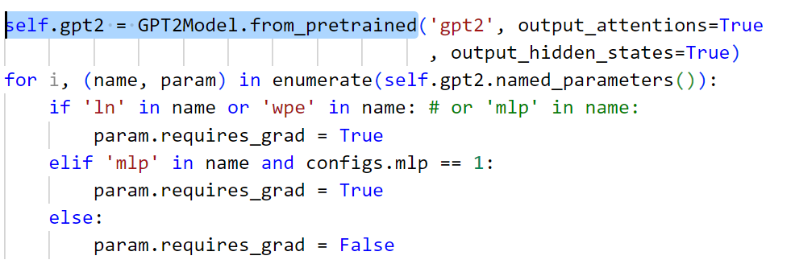
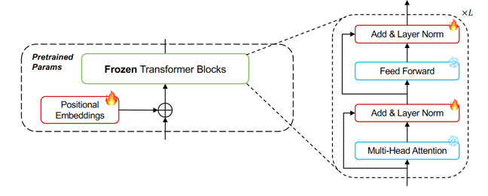
Code_Model
模型：微调Pos embd + Layernorm
task/models/GPT4TS.py

Slide 12
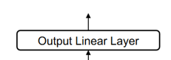
Code_Output
输出： Linear layers
task/models/GPT4TS.py

Slide 13
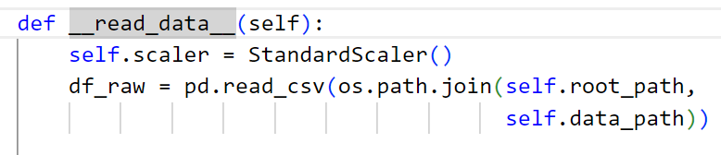
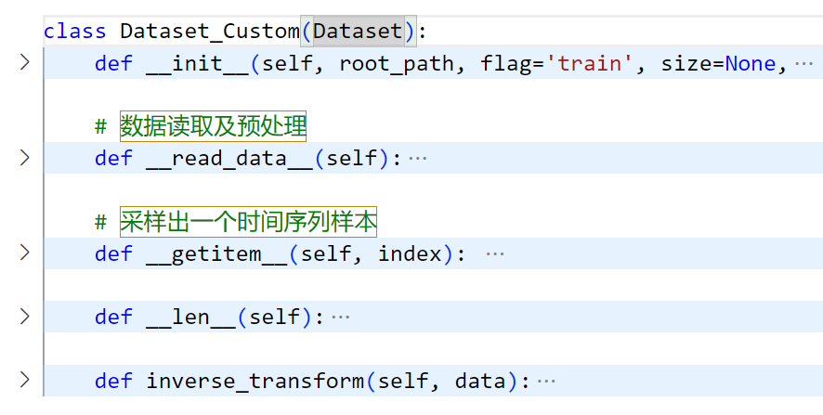
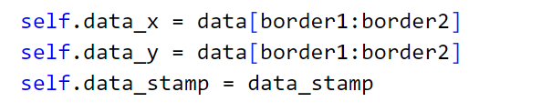
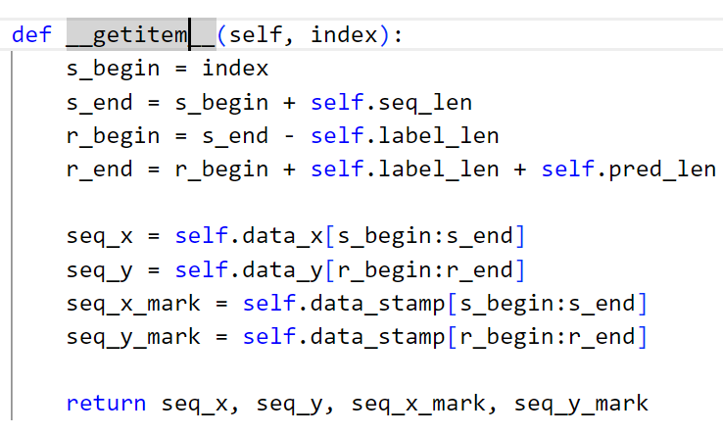
Code_Customize dataset
Step1: 建立一个Dataset
……
task/data_provider/data_loader.py

Slide 14
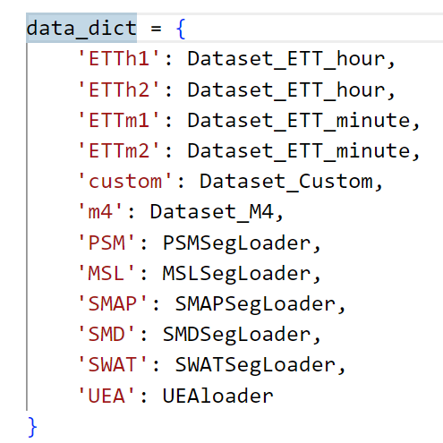
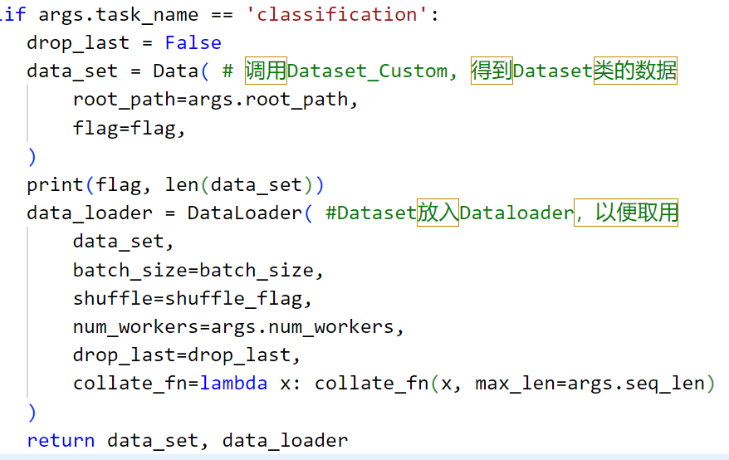
Code_Customize dataset
Step2: 把Dataset放入Dataloader
添加自己的数据集
把自己的Dataset放入Dataloader
task/data_provider/data_factory.py

Slide 15
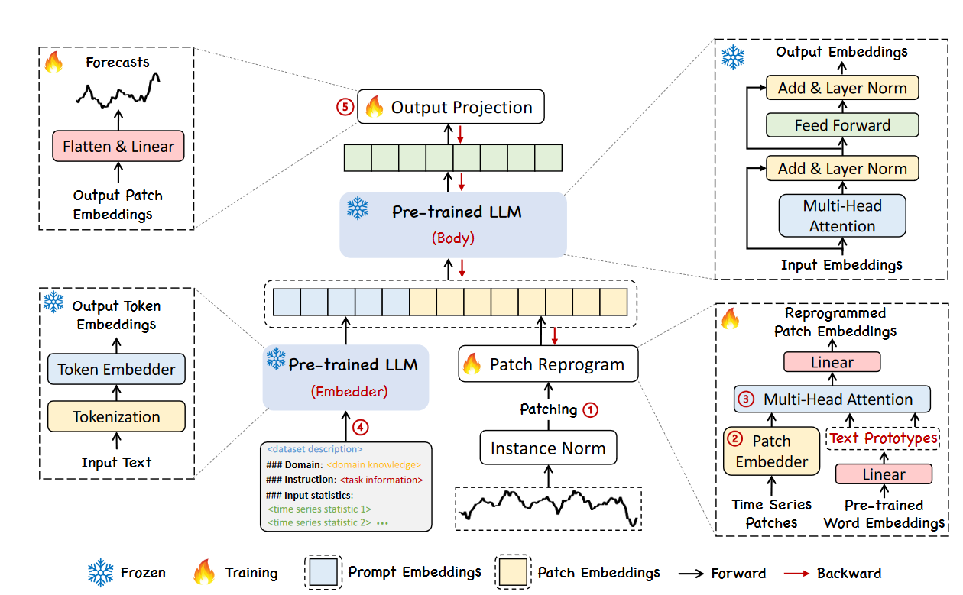
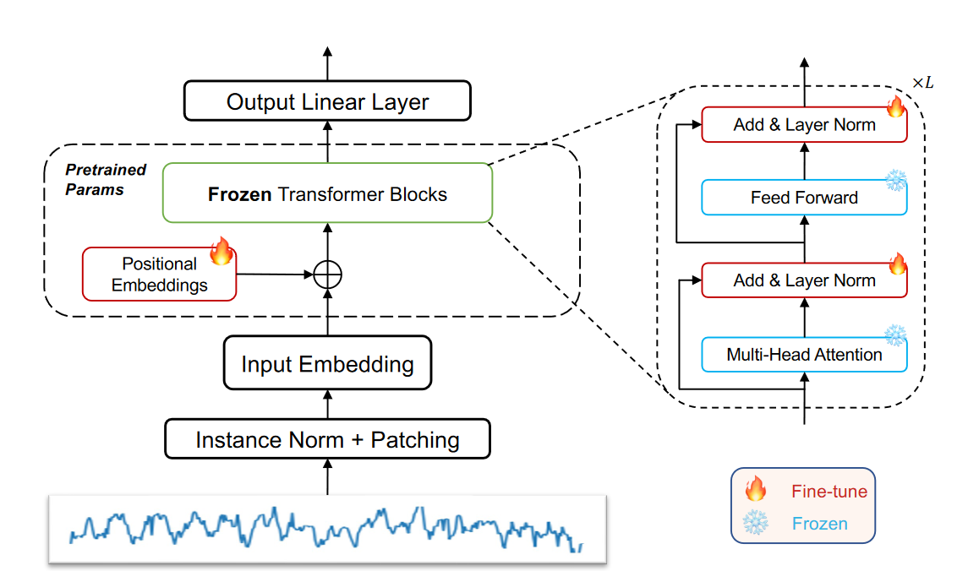
Time-LLM vs. OFA
固定LLM的参数
Reprogramming技术
文本提示prompt
Jin et al, Time-LLM: Time Series Forecasting by Reprogramming Large Language Models, ICLR 2024

Slide 16
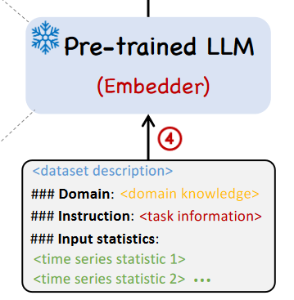
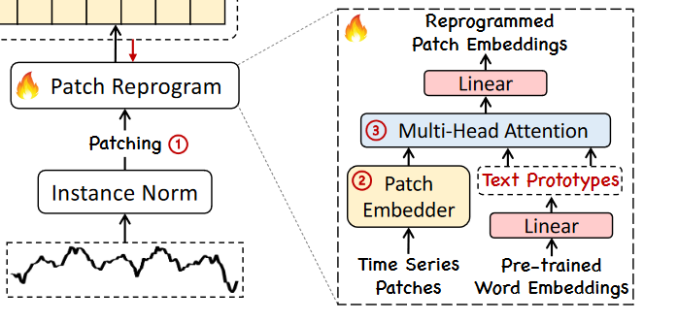
Time-LLM
Multi-head cross attention: 融合不同模态数据
文本prompt as prefix增强大模型推理能力
Jin et al, Time-LLM: Time Series Forecasting by Reprogramming Large Language Models, ICLR 2024

Slide 17
Concurrent works & future directions
LLM for other Regression Tasks
Vacareanu et.al, From Words to Numbers: Your Large Language Model Is Secretly A Capable Regressor When Given In-Context Examples, arxiv.org/abs/2404.07544
Explanability
Position Paper: What Can Large Language Models Tell Us about Time Series Analysis, https://arxiv.org/abs/2402.02713
LLM4TS
Sun et.al, TEST: Text Prototype Aligned Embedding to Activate LLM’s Ability for Time Series, ICLR 2024
Cao et.al, TEMPO: Prompt-based Generative Pre-trained Transformer for Time Series Forecasting, NeurIPS 2023
Notes:
time series prediction本质是一个regression问题，我们刚才讲的建模思路，原则上可以扩展到任何regression tasks

Slide 18
End
Thanks!
Notes:
time series prediction本质是一个regression问题，我们刚才讲的建模思路，原则上可以扩展到任何regression tasks

